Slide 1
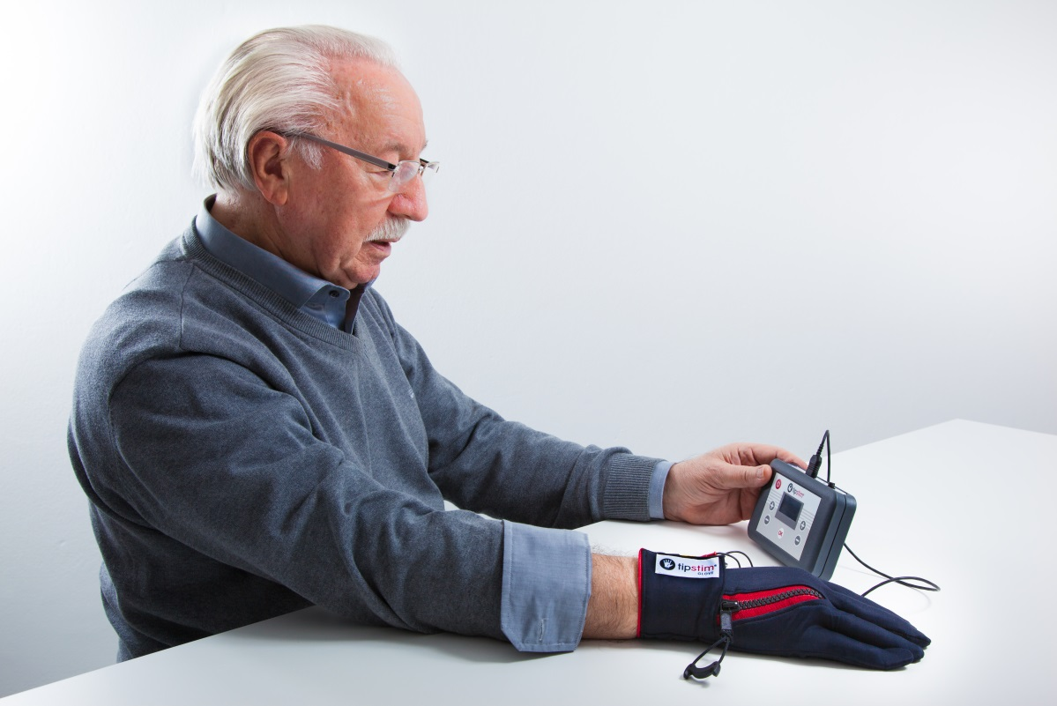
Brain stimulation at your fingertips A completely new approach in rehabilitation after stroke

Slide 2
tipstim® What is tipstim® about?
tipstim® is a completely new medical device, which has been developed in close cooperation with the institute of neuroinformatics at Ruhr-University Bochum, Germany (www.neuralplasticitylab.de).
tipstim® consists of a pulse generator (size of a pocket calculator) and of a high-tech glove (tipstim® glove).
tipstim® is used in rehabilitation of upper extremities with subacute stroke patients.

Slide 3
tipstim® I. Mechanisms of action - tipstim®
The pulse generator (tipstim®) sends specified stimulation patterns to the glove (tipstim® glove).
These impulses are transmitted to the fingertips via integrated electrodes made of a completely new, conductive textile material.
From the fingertips the impulses are transmitted via nerve pathways directly into brain regions being responsible for the sensorimotor functions of the upper extremities.

Slide 4
tipstim® I. Mechanisms of action - tipstim®
Stimulating the periphery has a direct effect on the brain and its reorganisation
Major enforcement of neuroplasticity
Restoration of sensory motor functions by reactivating cerebral areas affected by a stroke
Reinforcement of compensation processes in neighboring cerebral areas not directly affected by the stroke
Resulting in:
Substantial improvement in sensory motor abilities
The degree of improvement is comparable to standard rehabilitation measures after stroke

Slide 5
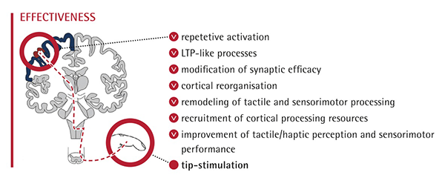
tipstim® I. Mechanisms of action - tipstim®
.

Slide 6
tipstim® I. Mechanisms of action - tipstim®
Background:
Long-term potentiation (LTP) processes are triggered by „high frequence“ – stimulation patterns, alternating with longer pause times. This leads to an increase in synaptic transmission.
In addition, a long-lasting, intense stimulation increases the neurotrophin release. This has been proven in animal studies by Madsen et al. (USA). Neurotrophins are endogenous signalling substances having a neuroprotective effect and supporting neuronal plasticity and growth.

Slide 7
tipstim® I. Mechanisms of action - tipstim®
Background:
Stimulation leads to a conversion (or reorganisation) of tactile and sensory motor neural processing.
This in turn leads to a restoration of the functions of the cerebral areas affected by a stroke and to compensation processes in neighboring cerebral areas not directly affected by the stroke. Sense of touch and grasping skills are improved by a changed communication between neurons.

Slide 8
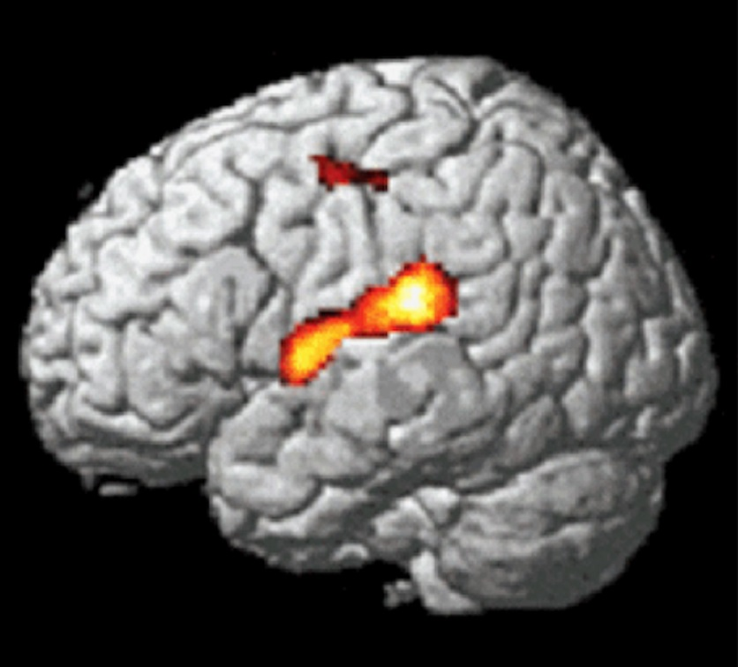
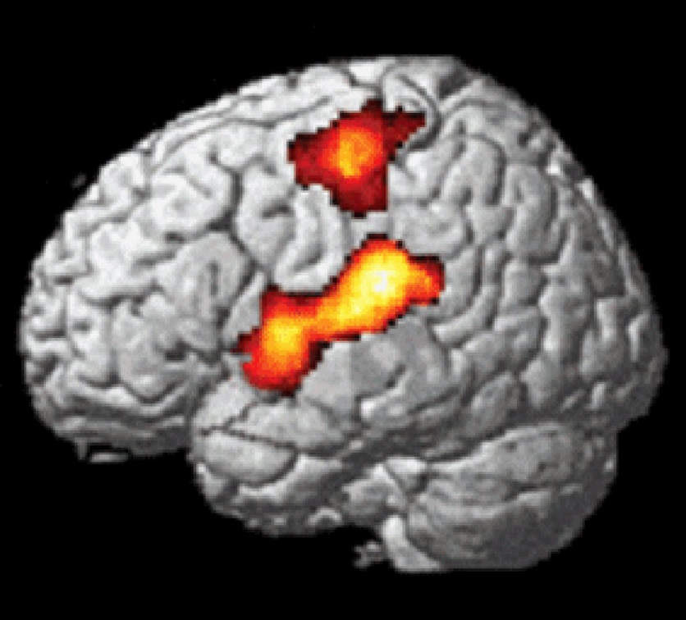
tipstim® I. Mechanisms of action - tipstim®
before after
Activation (MRT) of cerebral „hand“ areas before and after tip-stimulation

Slide 9
tipstim® I. Mechanisms of action - tipstim®
Differentiation from conventional stimulation methods like TENS/EMS
TENS/EMS-stimulation generally supports muscle functions to improve motor functions or to reduce pain
The only target of TENS/EMS stimulation are local nerves und muscles
In contrast to the TENS/EMS-therapy, tip-stimulation does not unspecifically modify conduction of neural paths. Tip-stimulation directly and simultaneously excites individual neuronal pathways of the mechanoreceptors of the fingertips („co-activation“). The prinicple of „co-activation“ is the only way to learn by passive stimulation (Hebbian theory, "what fires together, wires together")

Slide 10
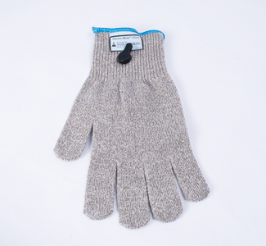
tipstim® I. Mechanisms of action - tipstim®
Differentiation from mesh glove
In contrast to tipstim® glove, mesh glove or other so-called stimulating gloves do not directly affect the fingertips but instead stimulate the complete hand. Depending on the electrical resistance of the skin different hand areas are stimulated in many ways by different intensities. This makes it impossible to directly target the fingertips.
At Neural Plasticity Lab in Bochum, Germany
mesh glove was tested against tipstim® glove
in healthy patients. In contrast to tipstim® glove,
mesh glove did not show any improvement in
sense of touch.

Slide 11
tipstim® II. Medical indications
Clinically proven
Subacute patients after ischaemic stroke (mRS/modfied Rankin-Scale 0-3)
Further more
Chronic stroke (case reports)
Under examination
CRPS (complex regional pain syndrome – formerly known as Morbus Sudeck) Very promising first results (defined sub-population) of a pilot study to be published soon.

Slide 12
tipstim® II. Medical indications
Modified Rankin-Skala (mRS):
0 - No symptoms.
1 - No significant disability. Able to carry out all usual activities, despite some symptoms.
2 - Slight disability. Able to look after own affairs without assistance, but unable to carry out all previous activities.
3 - Moderate disability. Requires some help, but able to walk unassisted.
4 - Moderately severe disability. Unable to attend to own bodily needs without assistance, and unable to walk unassisted.
5 - Severe disability. Requires constant nursing care and attention, bedridden, incontinent.
6 – Extreme disability

Slide 13
tipstim® IV. Contraindications and side-effects
Contraindications
Hypersensitivity to electrical stimulation
Cognitive impairment
Severe polyneuropathy or peripheral nerve lesions in the region of the affected extremity
A stroke any time in the last two weeks
Metal implants in the area to be treated
Wearers of cardiac pacemakers
Wearers of medical implants
Persons with cardiac damages
Epilepsy or increased epileptogenity
Remove hand or finger decoration

Slide 14
tipstim® IV. Contraindications and side-effects
Side-effects
None

Slide 15
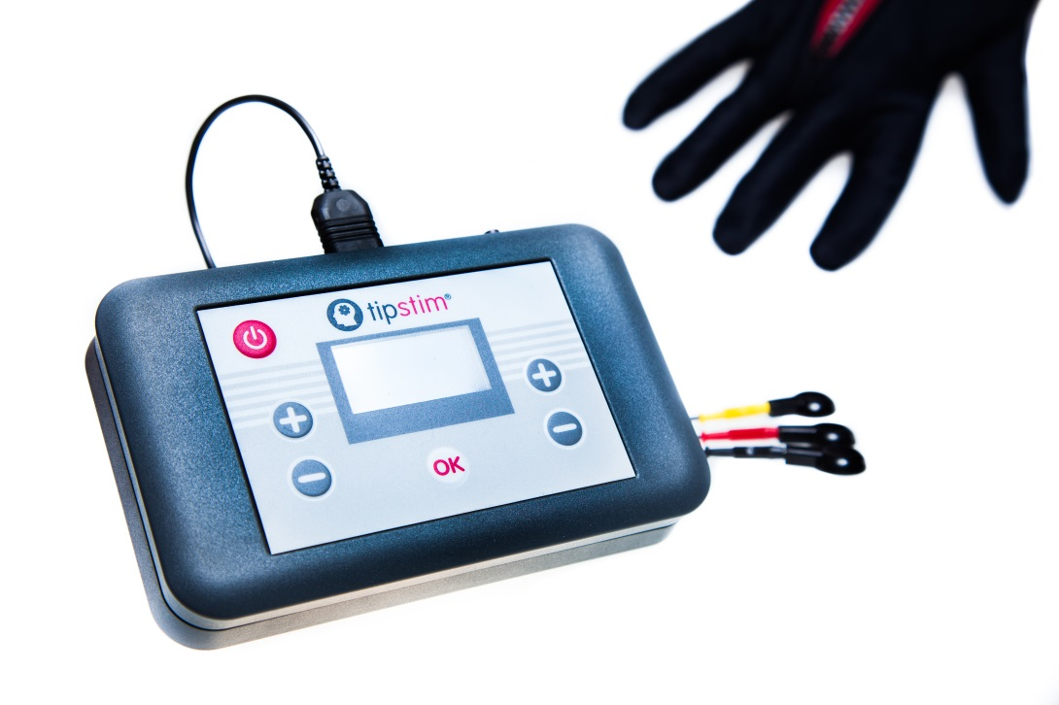
tipstim® V. Programme selection tipstim®
tipstim® features
2 independant and adjustable channels
2 preinstalled programmes

Slide 16
tipstim® V. Programme selection tipstim®
Why using 2 independently adjustable channels?
Fingertips being supplied by Nervus ulnaris respond more sensitively than those being suplied by Nervus medianus.
Tip-stimulation, however, stipulates that all fingertips are stimulated with an even subjective feeling.
2 indedependently adjustable channels allow the patient to stimulate the fingertips of both nerval areas with different objective levels of intensity which lead to an even subjective feeling.

Slide 17
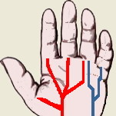
tipstim® V. Programme selection tipstim®
Nervus medianus
Nervus ulnaris

Slide 18
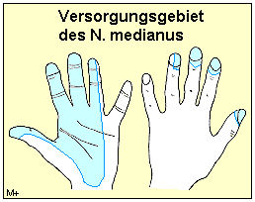
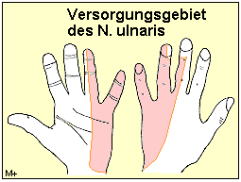
tipstim® V. Programme selection tipstim®

Slide 19
tipstim® V. Programme selection tipstim®
Programme 1:
Programme1 is the standard programme for the tip-stimulation.
Duration: 45 Minuten
Ratio current time to pause time: 2 sec : 5 sec
Ramp (rise time impulse): 0,3 sec
Frequency: 20 Hz
Pulse width: 300 µs
tipstim® has a so-called “Autorepeat“-Function, storing the current intensity which was selected last and providing this intensity automatically with the next therapy session (slightly increasing). However, this function can be deactivated by the medical professional , if desired.

Slide 20
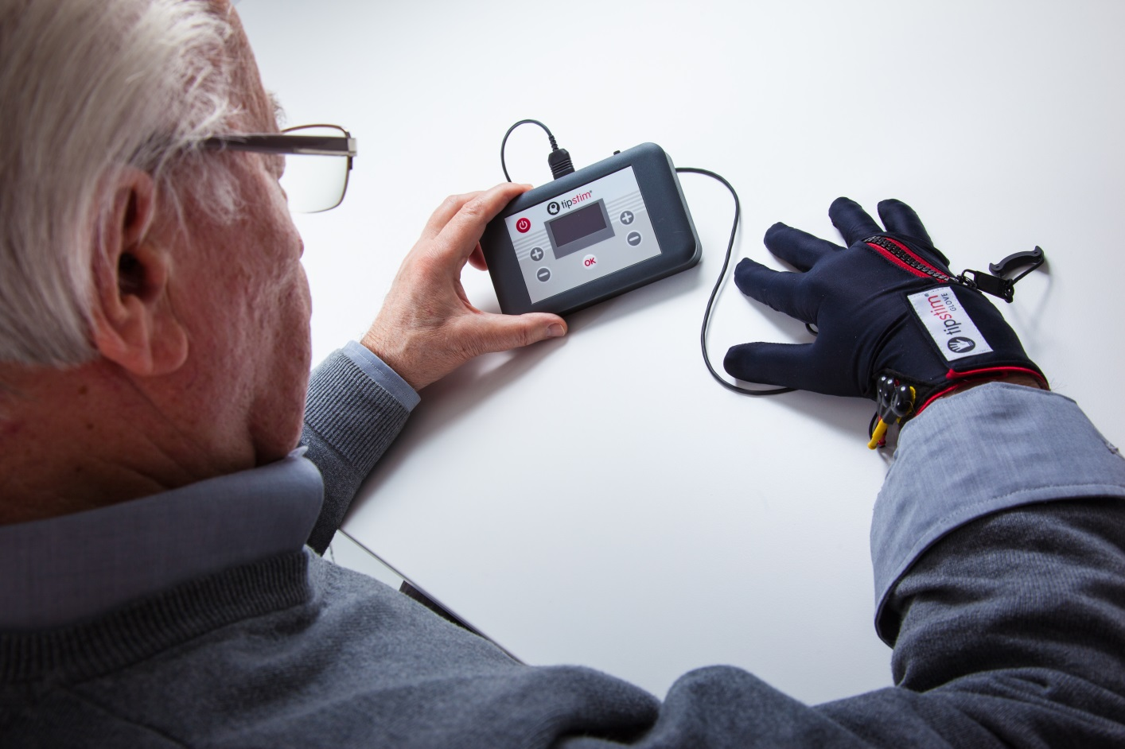
Many thanks for your attention.

